Slide 1


DEPARTMENT OF COMPUTER SCIENCE AND DESIGN
SCHOOL OF COMPUTING
10214CD601 MINOR PROJECT -1
SUMMER SEMESTER(2023-2024)
REVIEW-1
“OPINION MINING AND SENTIMENT ANALYSIS ON SOCIAL MEDIA”
SUPERVISED BY
PRESENTED BY
Dr. A . Bhagyalakshmi,ME.,PhD
1.NANDYALA NAVEEN REDDY (VTU20906)(21UEDL0020)
2.DALLI AKASH REDDY (VTU20933)(21UEDL0008)
3.G SIVA GANGADHAR (VTU20690)(21UECE0022)

Slide 2
AGENDA
ABSTRACT
OBJECTIVES
TIMELINE OF THE PROJECT
INTRODUCTION
LITERATURE REVIEW
DESIGN AND METHODOLOGIES
IMPLEMENTATION
CONCLUSION
REFERENCES

Slide 3
ABSTRACT
Sentiment analysis on social media is a natural language processing technique used to extract subjective information and opinions from user-generated content on various social media platforms, such as Twitter, Facebook, and Instagram.
The goal of this project is to perform sentiment analysis on social media data related to a particular topic or brand, such as a product launch or a social issue.
Social media data will be collected using relevant APIs or web scraping tools and preprocessed by cleaning and filtering out irrelevant or spammy content.
A sentiment analysis model, such as a machine learning model, will be applied to classify the sentiment of the content as positive, negative, or neutral.
Results will be visualized and analyzed using various techniques and tools, such as word clouds, bar charts, and time series analysis, to gain insights and make data-driven decisions based on public opinion.
Challenges in social media sentiment analysis include the use of slang, emojis, and hashtags, as well as the need to handle multilingual content.
Sentiment analysis on social media can be a powerful tool for understanding public opinion, customer satisfaction, and brand reputation, and making data-driven decisions in various domains, such as marketing, politics, and social sciences

Slide 4
OBJECTIVES
Aim of the project:
The aim of a project on Opinion Mining and Sentiment Analysis on Social Media is to analyze and understand the opinions and sentiments expressed by users on various social media platforms.
Scope of the project:
Platform Selection
Data Collection
The scope of the project is to judge whether our product is a good one/bad one.
This helps the people to know the opinion of others regarding any posted one.
The developers can understand their faults and can correct their mistakes.
This makes to enhance the quality and popularity of the product.
This helps to find the harmful content on social media platform based on the reviews given by the users.

Slide 5
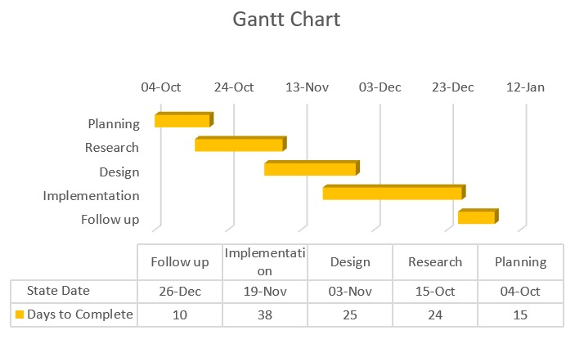
TIMELINE OF THE PROJECT

Slide 6
INTRODUCTION
Sentiment analysis is a natural language processing and machine learning technique used to extract subjective information from user-generated content on social media platforms.
Social media sentiment analysis can help companies and organizations to monitor brand reputation, identify emerging trends and patterns, and make data-driven decisions based on public opinion.
To start a sentiment analysis project, you need to define the scope and goals of your project, choose a social media platform and data type, and collect and preprocess the data.
Preprocessing involves cleaning and preparing the data, such as removing irrelevant or spammy content, removing stop words, and converting text to lowercase.
There are various sentiment analysis models and techniques, such as rule-based models, lexicon-based models, and machine learning models, that can be applied to the preprocessed data to classify sentiment as positive, negative, or neutral.
After sentiment classification, the results can be visualized and analyzed using various techniques and tools, such as word clouds, bar charts, and time series analysis, to gain insights and make data-driven decisions based on public opinion.
Sentiment analysis on social media can be a powerful tool for understanding public opinion and making data-driven decisions in various domains, such as marketing, politics, and social sciences.

Slide 7
LITERATURE REVIEW
Author’s Name | Paper name and publication details | Year of publication | Main content of the paper
R. Meena,V. Thulasi Bai | pp.145-188 | 2019 | Study on Machine learning based Social Media and Sentiment analysis for medical data applications
Hariharan R,R. Sophia Janit | pp.1465-1468 | 2023 | Social Media Content Recommendation System using Knn Algorithm
Shuo Wen, Peixin Wang, Jinying Zheng | pp.362-368 | 2022 | AI Enabled Educational Bot to Improve Learning Outcomes using Bag of Words Algorithm

Slide 8
Author’s Name | Paper name and publication details | Year of publication | Main content of the paper
Akash Ambashankar, Ganesh Chandrasekar, Charan A R, Sankar S | pp.574-579 | 2022 | Exploration of Performance of Dynamic Branch Predictors used in Mitigating Cost of Branching

Slide 9
DESIGN AND METHODOLOGIES
MODULE 1: UPLOAD MODULE
MODULE 2: COMMENT MODULE

Slide 10
MODULE 1
Step:1 Upload Module
It is a module in which the people post any topic related to them. This posting of topic will make the others users to see the topic. So that the users who view that posted topic can comment their opinion about the posted topic.
we download the dataset from Kaggle and extracted the dataset. The data set we download will apapear as follows

Slide 11
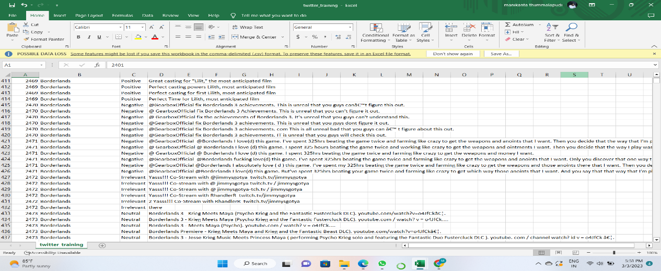
Step 2: Processing the data

Slide 12
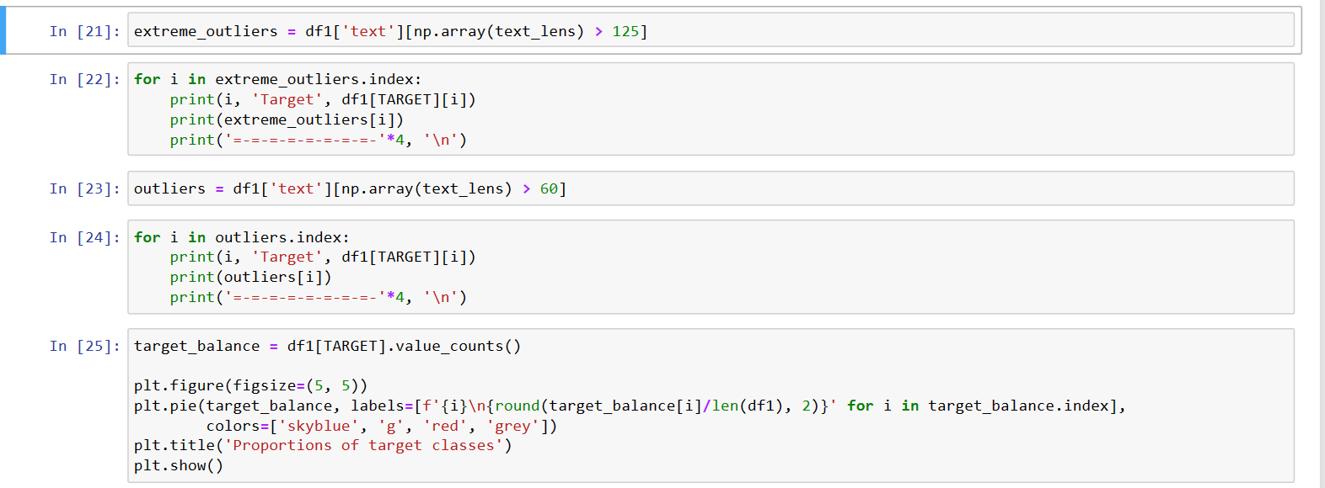
Step 3: Apply Machine Learning Algorithms

Slide 13
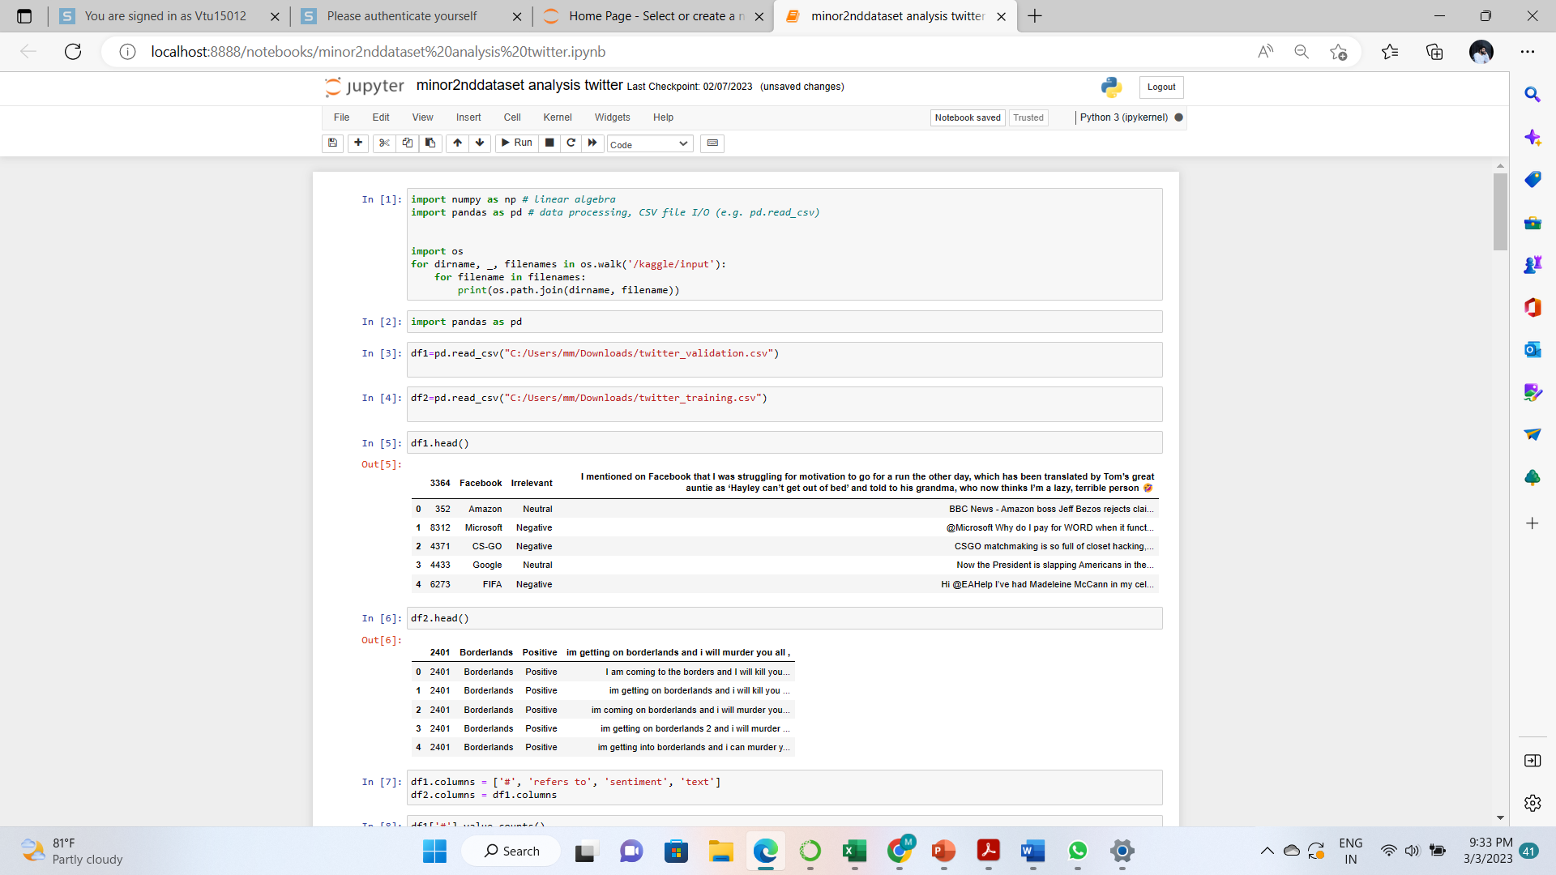
Step 4: Output

Slide 14
Module 2
Step 1: Comment module
This is a module in which the users post their opinions in form of comments about the topic posted by other people.
In this module, everyone can see the comments posted by the people.
The comment is just like a text message. It allows to type small, big characters, numbers and symbols, emojis.

Slide 15
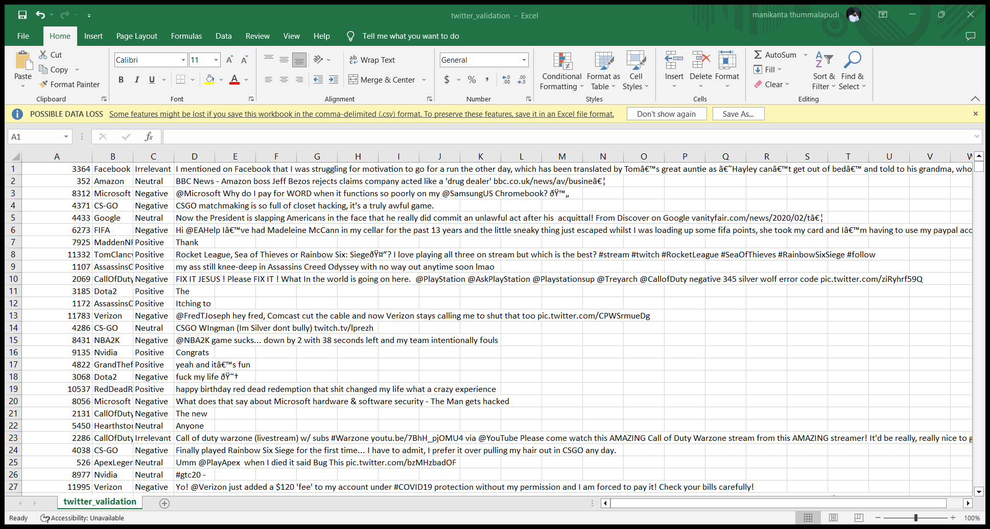
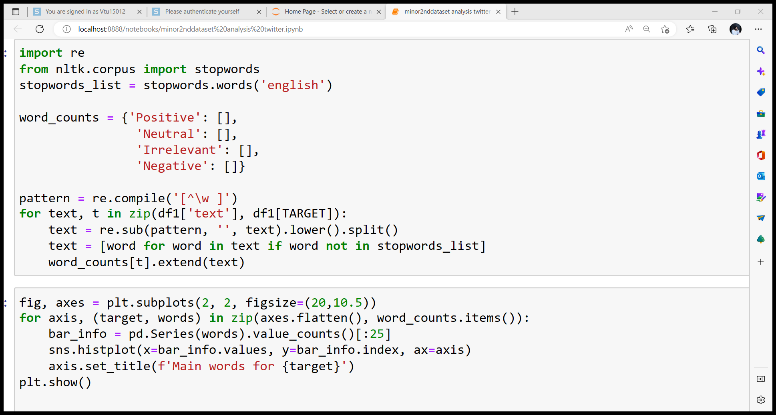
Step 2: Analyzing the data
Step 3: Apply Machine Learning Algorithms

Slide 16
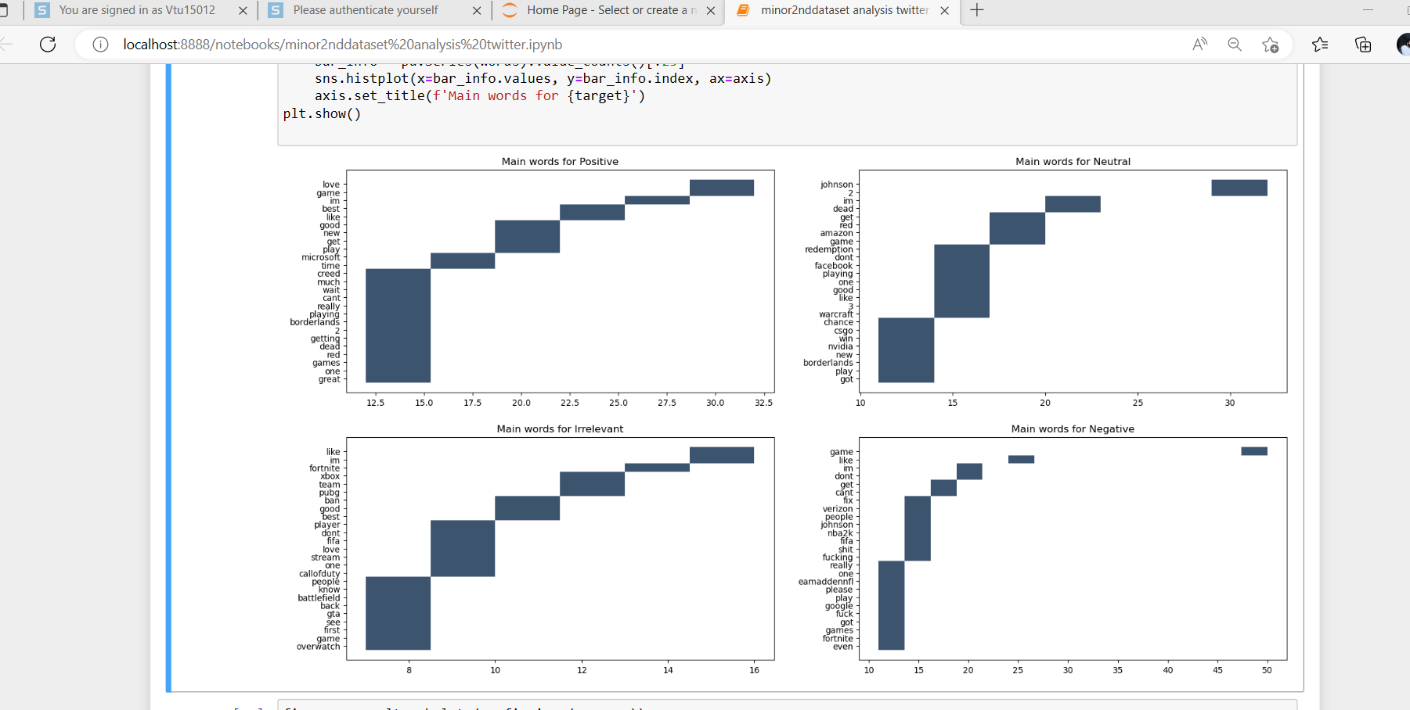
Step 4: The output

Slide 17
IMPLEMENTATION
Architecture Diagram
Data –Flow Diagram
Use Case Diagram
Class Diagram
Activity Diagram
Sequence Diagram
Collaboration Diagram(If applicable)
E-R Diagram

Slide 18
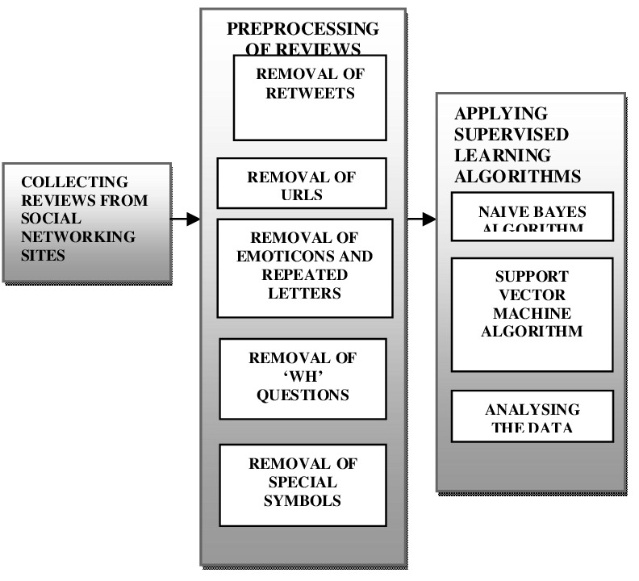
Architecture Diagram

Slide 19
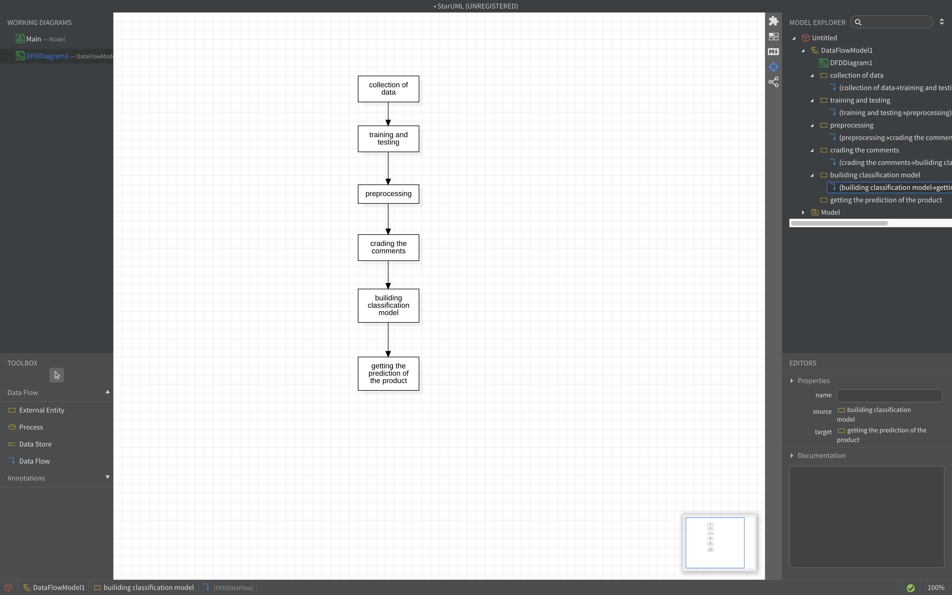
Data –Flow Diagram

Slide 20
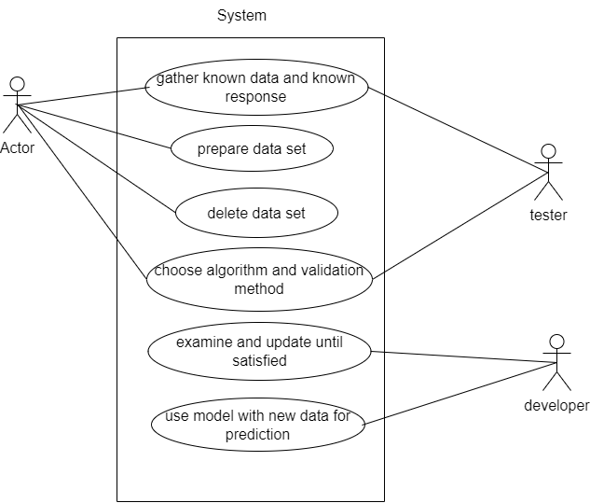
Use Case Diagram

Slide 21
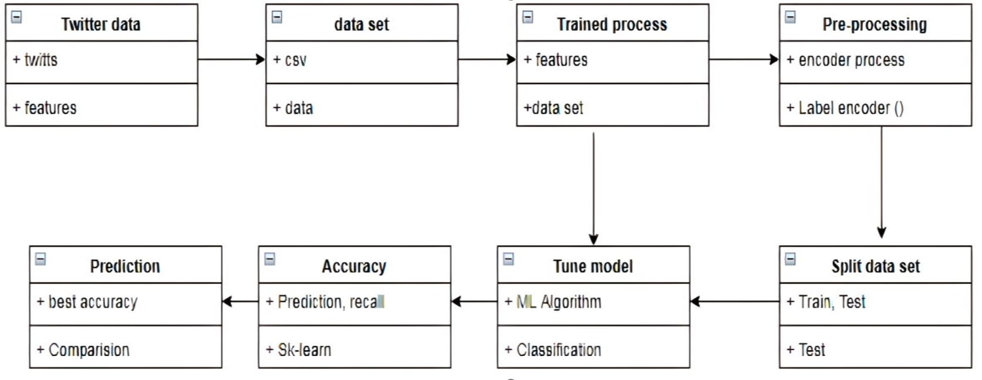
Class Diagram

Slide 22
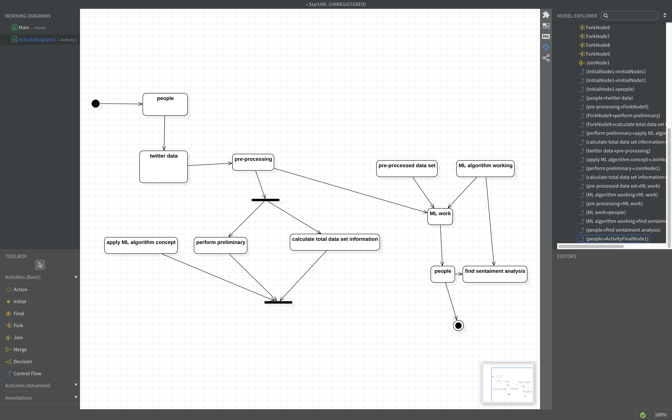
Activity Diagram

Slide 23
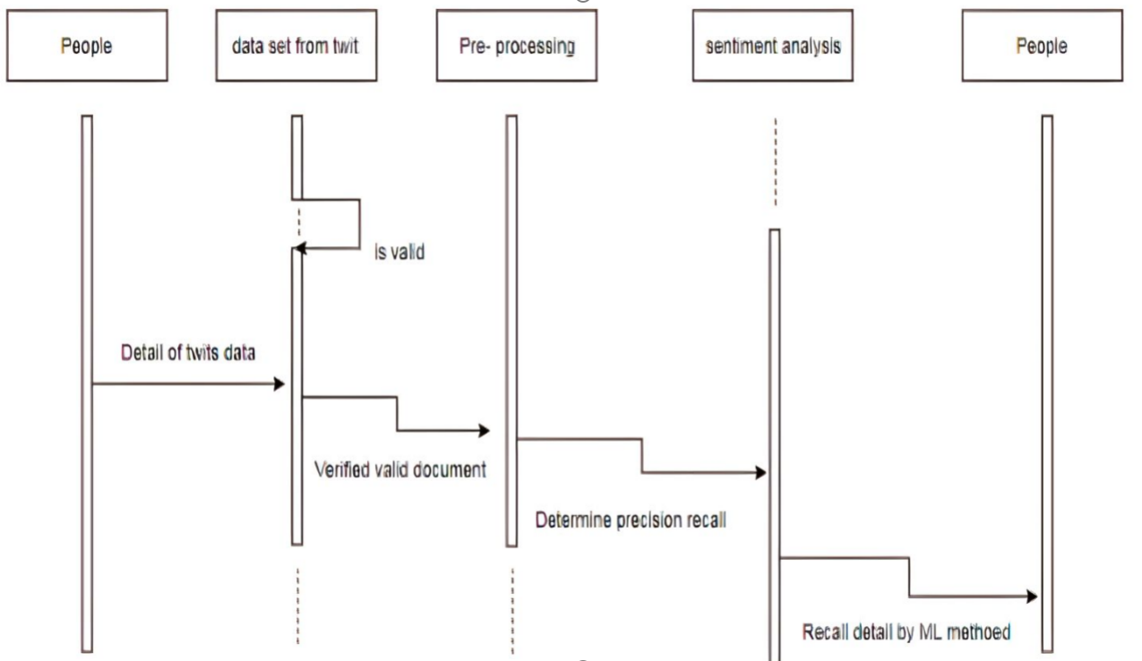
Sequence Diagram

Slide 24
REFERENCES
[1] “Thai Kim Phung1, Nguyen An Te2, Tran Thi Thu Ha2 University of Economics Ho Chi Minh City, Vietnam
National Economics University, Vietnam ACIS International Winter Conference on Software Engineering,
Artificial Intelligence, Networking and Distributed Computing (SNPD-Winter)2021”
[2] Rawan Fahad Alhujaili ,Department of Computer Science,College of Computer Science and Engineering, Taibah University, “Sentiment Analysis for Youtube Videos with User Comments : Review”,International Conference on Artificial Intelligence and Smart Systems (ICAIS-2021) IEEE Xplore Part Number: CFP21OAB-ART; ISBN: 978-1-7281-9537-7
[3]Nourin Islam,Ms.Nasrin Akter,Department of Computer Science & Engineering Department of Computer Science & Engineering, University Daffodil International University, “Sentiment Analysis on Food Review using Machine Learning Approach”,2021
[4]Nikhil Yadav, Omkar Kudale Srishti Gupta, Department of computer engineering, International Institute of Information Technology, Pune, “Twitter Sentiment Analysis Using Machine Learning For Product Evaluation ”,International Conference on Inventive Computation Technologies (ICICT-2020)

Slide 25
[5]Ritwik Murali, Akash Ravi,Dept. of Computer Science and Engineering ,Amrita School of Engineering, Coimbatore, “Enhancing Digital Well-being using Opinion Mining and Sentiment Classifiers” International Conference on Inventive Computation Technologies (ICICT-2020)
[6]Jieyu Ding Featherstone, George A, Department of Communication ,University of California, Davis,” Validating Sentiment Analysis on Opinion Mining Using Self-reported Attitude Scores”, Seventh International Conference on Social Networks Analysis, Management and Security (SNAMS),2020

Slide 26
THANK YOU

